Slide 2
Secure Over The Air (OTA) updates for embedded IoT devices
Presenter: Roman Okhrimenko (Staff System Engineer)

Slide 3
Topics to cover in this presentation
What are Over The Air Updates
Architecture of Over The Air update system
Infrastructure and firmware requirements
Communication and security considerations
Cryptographic tools

Slide 4
Terms and definitions
OTA – Over The Air Update
AWS – Amazon Web Services
Secure Bootloader – bootloader, that is able to verify cryptographic signatures
MCUBoot – open source secure bootloader library
Amazon FreeRTOS – real time operationg system for embedded devices with AWS support
Digital Signature – a way to verify authenticity of message/firmware using cryptography
Hash – cryptographycally calculated value, that is unique to certain set of data
MQTT – lightweight publish/subscribe type of protocol widely used in IoT
TLV – tag length value record format

Slide 5
OTA Building blocks
This is complex task
IoT device
Wi-Fi
MQTT
Bootoader
OpenSSL
Verification
BLE
MbedTLS
RTOS
Cloud
Storage
ECDSA
RSA
X509
TLS
Certificate
Flash
OTA service support

Slide 6
Types of OTA Design
Edge-to-cloud OTA updates: An internet-connected microcontroller is capable of receiving new firmware images from a remote server. These images can contain updates to both the microcontroller’s underlying hardware capabilities, as well as to the application running on top of them.
Gateway-to-cloud OTA updates: An internet-connected gateway, responsible for managing a fleet of local edge devices, is capable of receiving updates from a remote server that alters any or all of its software application, the software application’s host environment, and / or the gateway device’s firmware.
Edge-to-gateway-to-cloud OTA updates: An internet-connected gateway is responsible for managing a fleet of locally connected edge devices, which in turn are capable of receiving remote firmware updates via the gateway.

Slide 7
OTA Design Considerations
Automatic recovery from corrupted or interrupted updates.
Code provenance and integrity checks are essential.
Code compatibility verification is advisable.
Use secure communication channels by default.
Partial updates should be possible.

Slide 8
OTA for Multiple Processors
shorturl.at/azAO3

Slide 9
Over The Air Update Scheme
shorturl.at/evwUY

Slide 10
Building Blocks For This Discussion
Secure Bootloader
MCUBoot based bootloader
Amazon Free RTOS
Operating system for connected embedded devices
PSoC62
Cypress dual-core microcontroller
AWS IoT Services
Amazon Cloud IoT devices management service

Slide 11
MCUBoot based bootloader
Link to download - https://github.com/JuulLabs-OSS/mcuboot
Features:
1. Single/multi image boot schemes
2. Reversible upgrades support
3. RSA/ECDSA Image signature verification
4. Tools for signing images included

Slide 12
MCUBoot: Digital signing idea

Slide 13
MCUBoot: flash map
MCBootApp
0x10000000
MCBootApp
0x10000000
Img1_SLOT0
0x10012000
Img1_SLOT0
0x10012000
Img1_SLOT1
Img1_SLOT1
0x10100000
Img2_SLOT0
0x10100000
Img2_SLOT1
Scratch Area
0x101EE000
ImgN_SLOT0
0x101xx000
Single image boot scheme
ImgN_SLOT1
Scratch Area
Multi image boot scheme

Slide 14
MCUBoot: image format
Image header
Firmare
SWAP status area
TLV header
Protected TLVs
Enc Key 0
TLV header
Enc Key 1
SHA256 hash
Swap Info
Keyhash
Copy Done
Signature
…
Image OK
TLV
Image trailer
MAGIC
TLV area
MCuBoot image
Image trailer

Slide 15
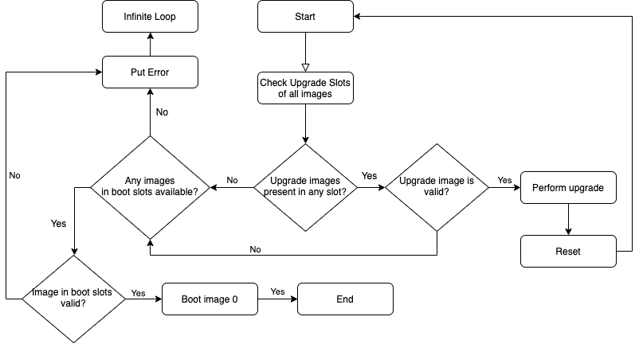
MCUBoot: Bootloading chart

Slide 16
MCUBoot: Reversible Upgrade
Implemented using SWAP images operation
Two types of SWAP available – via scratch area and by move
Number of SWAP modes available – test, permanent, etc
Upgraded image callback to mark image is OK
Renewable SWAP upgrade supported in case of power loss
Multi image support
Swap status area in image trailer keeps
status of SWAP operation per image sector
written in flash.

Slide 17
MCUBoot: Imgtool
Included with MCUBoot library
Maintained along with MCUBoot
Written in python and available via PyPIP
Functionality
Sign images using ECDSA/RSA keys
Fill TLV fields in image
Fill header data in image per hex file provided
Reserves and fills image trailer area
Work with bin and hex files
Generate keys

Slide 18
Amazon FreeRTOS – operating system
https://docs.aws.amazon.com/freertos/latest/userguide/what-is-freertos.html

Slide 19
Amazon FreeRTOS – kernel
FreeRTOS kernel scheduler
Kernel memory allocation
Application memory management
Intertask coordination
Queues
Semaphores and mutexes
Direct-to-task notifications
Stream buffers
Message buffers
Software timers
Low power support

Slide 20
Amazon FreeRTOS – libraries
Libraries require ports for hardware support
Most likely implemented for platform of choise
Wi-Fi – set of basic APIs need to implemented
TCP/IP – transport/internet layer
FreeRTOS+TCP – TCP/IP stack for the FreeRTOS kernel
lwIP – alternative light weight TCP/IP stack
TLS – transport layer security implemented via commonly used mbedTLS library
PKCS #11 – FreeRTOS uses the open standard PKCS #11 “CryptoKi” API as the abstraction layer for cryptographic operations
MQTT – application level communication protocol used in IoT
HTTPS – HTTPS/1.1 over TLS
OTA agent – client side of over the air update library implementation

Slide 21
Amazon FreeRTOS – libraries
Libraries require ports for hardware support
Most likely implemented for platform of choise
Wi-Fi – set of basic APIs need to implemented
TCP/IP – transport/internet layer
FreeRTOS+TCP – TCP/IP stack for the FreeRTOS kernel
lwIP – alternative light weight TCP/IP stack
TLS – transport layer security implemented via commonly used mbedTLS library
PKCS #11 – FreeRTOS uses the open standard PKCS #11 “CryptoKi” API as the abstraction layer for cryptographic operations
MQTT – application level communication protocol used in IoT
HTTPS – HTTPS/1.1 over TLS
OTA agent – client side of over the air update library implementation

Slide 22
AWS IoT Core – cloud services for devices
Core - is a managed cloud service that lets connected devices easily and securely interact with cloud applications and other devices.
AWS IoT Device SDK
Device Gateway
Message Broker
Authentication and Authorization
Registry
Device Shadow
Rules Engine
https://aws.amazon.com/iot-core/features/

Slide 23
AWS IoT Core – cloud services for devices
Placeholder
https://docs.aws.amazon.com/whitepapers/latest/aws-overview/internet-of-things-services.html

Slide 24
AWS Services to support OTA updates
Amazon IoT Core – manage connected devices
Create and manage IoT things, associated with devices
Manage access certificates and policies for devices
Create and monitor jobs associated with devices (OTA)
Debug things remotely via cloud
Amazon S3 – storage service to place OTA update binaries
Amazon (IAM) - Identity and Access Management
OTA Update service role
OTA user policy
Manage access for awscli tool
Amazon ACM – certificate management service
Code signing certificates

Slide 25
PSOC62: hardware platform
Dual core design – CM0p + CM4 cores
Hardware acceleration of crypto operations – mbedTLS alt layer
Wi-Fi + BLE chips integrated on development kits
External flash supported on kit

Slide 26
OTA Agent
placeholder

Slide 27
Refferences
https://dzone.com/articles/how-to-approach-ota-updates-for-iot

